Slide 1
Weather Forecast Infographics
Here is where this template begins

Slide 2
Weather Forecast Infographics
Monday | Tuesday | Wednesday | Thursday | Friday | Saturday | Sunday
11° | 13° | 12° | 9° | 12° | 10° | 11°
Mars is a cold place | Venus has a nice name | It’s the biggest one | Pluto is a dwarf planet | Saturn is the ringed one | Neptune is the farthest | Mercury is very small

Slide 3
Weather Forecast Infographics
Jupiter is the biggest planet
Jupiter
11°
Mercury is the smallest planet
Mercury
15°
Venus
8°
Venus has a beautiful name
Earth
18°
Earth is the third one from the Sun

Slide 4
Weather Forecast Infographics
Local weather
Sea forecast
17 km/h
Wind speed
12 knots
Wind direction
SW
Sunday
SW
Wave
2.2 m
Sunny
Monday
Tuesday
Wednesday
Thursday
Friday
Sunny
Rainy
Rainy
Sunny
Sunny
22°C / 71.6°F
22°C / 71.6°F
22°C / 71.6°F
22°C / 71.6°F
22°C / 71.6°F

Slide 5
Weather Forecast Infographics
Germany
Current | 20°
Day | 23°
Night | 14°
Spain
Current | 24°
Day | 25°
Night | 19°
Italy
Current | 23°
Day | 24°
Night | 20°

Slide 6
Weather Forecast Infographics
Monday
Tuesday
Wednesday
Thursday
22°C
Berlin
22°C
22°C
22°C
August 26
August 27
August 28
August 29
Jupiter is the biggest planet
Venus has a beautiful name
Earth is the third one from the Sun
Mercury is the smallest planet

Slide 7
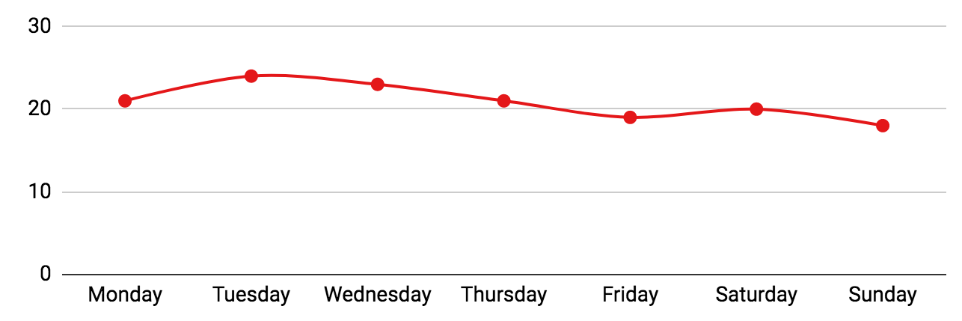
Weather Forecast Infographics
21°C 15°C | 24°C 21°C | 23°C 19°C | 21°C 18°C | 19°C 14°C | 20°C 17°C | 18°C 16°C
Follow the link in the graph to modify its data and then paste the new one here. For more info, click here

Slide 8
Weather Forecast Infographics
Mercury
15°
16 km/h
60%
Venus
18°
Neptune
13°
23 km/h
26 km/h
20%
45%

Slide 9
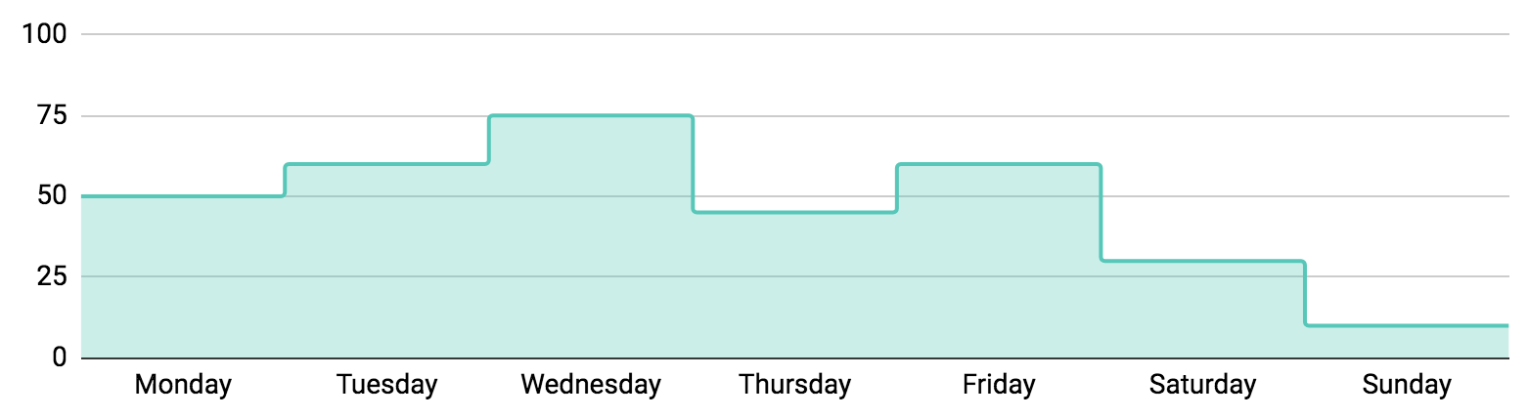
Weather Forecast Infographics
50%
60%
75%
45%
60%
30%
10%
22°C
Humidity 71%
Wind 16 km/h
Mercury is the closest planet to the Sun and the smallest one
Follow the link in the graph to modify its data and then paste the new one here. For more info, click here

Slide 10
Weather Forecast Infographics
12:00 pm | Monday
22°
Feels like 21° | Sunny
Humidity 57%
Wind NE4
Dew point 21°
01:00 pm | Monday
21°
Feels like 21° | Sunny
Humidity 58%
Wind NE4
Dew point 21°
02:00 pm | Monday
20°
Feels like 18° | Cloudy
Humidity 65%
Wind NE4
Dew point 20°
03:00 pm | Monday
18°
Feels like 21° | Rainy
Humidity 58%
Wind NE4
Dew point 21°

Slide 11
Weather Forecast Infographics
2 pm | 22°C |  | Sunny |  | 10% |  | SE 9 mph
3 pm | 21°C |  | Rainy |  | 11% |  | E 7 mph
4 pm | 18°C |  | Cloudy |  | 12% |  | ENE 5 mph
5 pm | 23°C |  | Sunny |  | 15% |  | SE 9 mph
6 pm | 24°C |  | Rainy |  | 20% |  | E 8 mph
7 pm | 19°C |  | Rainy |  | 13% |  | E 9 mph
8 pm | 22°C |  | Sunny |  | 11% |  | SE 9 mph
9 pm | 21°C |  | Cloudy |  | 10% |  | ENE 5 mph

Slide 12
Weather Forecast Infographics
22°
24°
21°
Partly cloudy
Sunny
Rainy
Wind
SE 10 mph
Wind
SE 8 mph
Wind
E 7 mph
Humidity
65%
Humidity
45%
Humidity
75%
UV index
UV index
UV index
5/10
6/10
7/10

Slide 13
Weather Forecast Infographics
The weather for the weekend
Friday 08
Saturday 09
22°
ENE 9 mph
20°
SE 11 mph
80%
60%
Mercury is the closest planet to the Sun and the smallest one
6:03 am
8:05 pm
Sunday 10
Humidity
UV index
21°
SW 14 mph
83%
0/10
40%
6:00 am
8:00 pm
5:59 am
8:02 pm

Slide 14
Weather Forecast Infographics
Madrid
Mercury is the closest planet to the Sun and the smallest in the entire Solar System
Monday
Tuesday
Wednesday
Thursday
Friday
26°C
24°C
22°C
23°C
25°C
August 15
August 16
August 17
August 18
August 19

Slide 15
Weather Forecast Infographics
Paris
Sunrise 6:30 am
September 21, Monday
Sunset 19:30 pm
22°
60%
Feels like 21°
Partly cloudy
1024.0 mbar
25° | 23° | 22° | 19° | 22° | 20°
Tuesday | Wednesday | Thursday | Friday | Saturday | Sunday

Slide 16
Weather Forecast Infographics
Monday
Tuesday
Wednesday
Thursday
Friday
August 15
August 16
August 17
August 18
August 19
25°C
24°C
22°C
20°C
25°C
min. 19º C
min. 21º C
min. 17º C
min. 18º C
min. 20º C

Slide 17
Weather Forecast Infographics
Rainy
Windy
It’s the closest planet to the Sun
Jupiter is the biggest planet
Weather
Forecast
Sunny
Cloudy
Despite being red, Mars is cold
Venus has a beautiful name

Slide 18
Weather Forecast Infographics
Dallas
ENE 9 mph
85%
Mon
Tue
Wed
Thu
Fri
25°C
24°C
22°C
20°C
25°C
Dallas
Austin
SW 8 mph
85%
Austin
Mon
Tue
Wed
Thu
Fri
23°C
20°C
21°C
18°C
22°C

Slide 19
Weather Forecast Infographics
24°
26°
9°
New York
Nairobi
Moscow
Humidity: 60%
Visibility: Good
Pressure: 1024 mbar
Humidity: 40%
Visibility: Good
Pressure: 1010 mbar
Humidity: 30%
Visibility: Good
Pressure: 1024 mbar
40%
20%
40%
Jupiter is a gas giant
Mars is a cold planet
It has a nice name

Slide 20
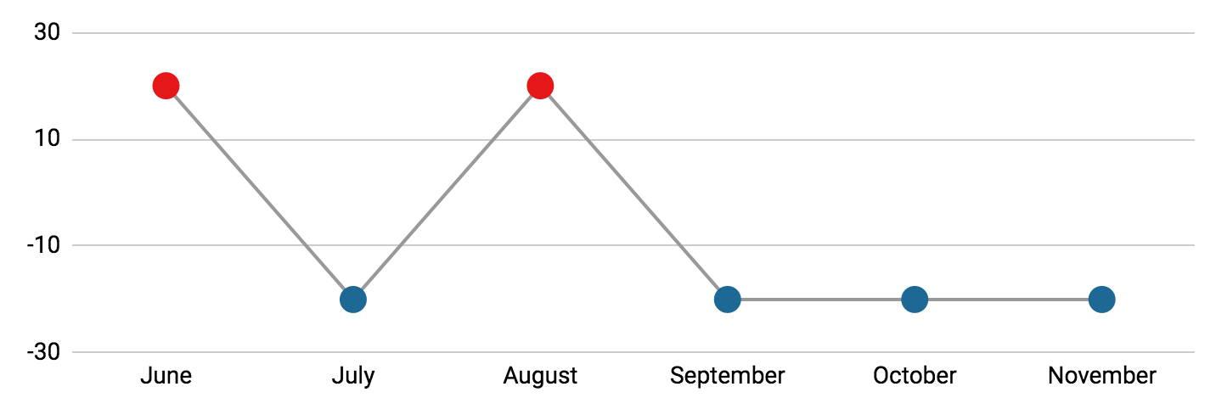
Weather Forecast Infographics
Mercury
30%
70%
Jupiter
It’s the closest planet to the Sun
Jupiter is the biggest planet
Follow the link in the graph to modify its data and then paste the new one here. For more info, click here

Slide 21
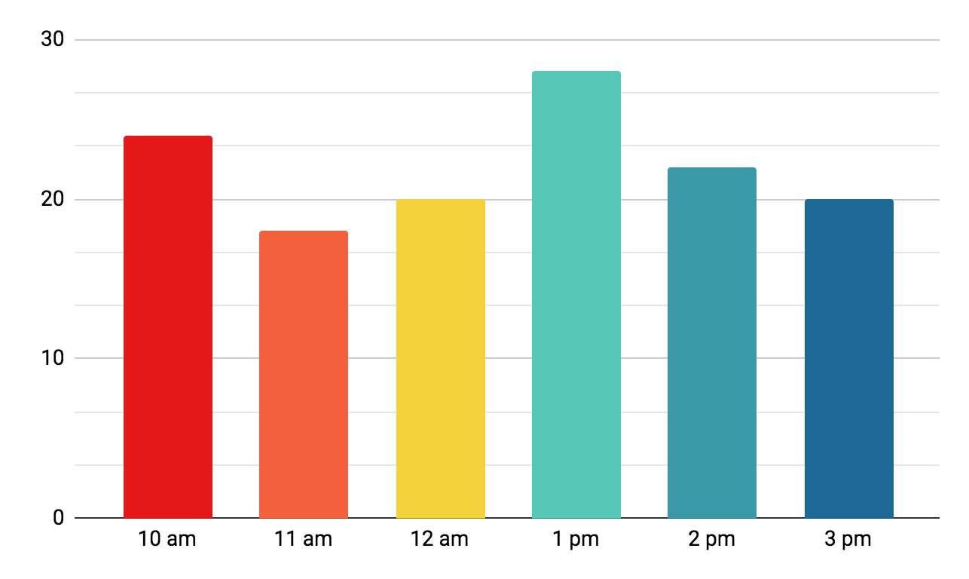
Weather Forecast Infographics
Barcelona
Clear
24°
Feels like 22°
18°
Humidity: 60%
Visibility: Good
Pressure: 1024 mbar
25°
Follow the link in the graph to modify its data and then paste the new one here. For more info, click here

Slide 22
Weather Forecast Infographics
Monday
Tuesday
Wednesday
October 15
October 16
October 17
21°C
23°C
22°C
Sunny
Cloudy
Rainy
7:21
17:40
7:19
17:45
7:23
17:43
Mercury is the closest planet to the Sun
Despite being red, Mars is a cold planet
Venus is the second planet from the Sun

Slide 23
Weather Forecast Infographics
Monday
Tuesday
Wednesday
Thursday
6:00 am
6:02 am
6:05 am
6:00 am
8:00 pm
8:00 pm
8:05 pm
8:00 pm
Sunny
Rainy
Rainy
Sunny
21°C / 70.6°F
22°C / 71.6°F
23°C / 72.6°F
22°C / 71.6°F
Friday
Saturday
Sunday
Monday
6:03 am
6:00 am
5:59 am
6:05 am
8:01 pm
8:00 pm
8:01 pm
8:10 pm
Rainy
Stormy
Sunny
Sunny
22°C / 71.6°F
21°C / 70.6°F
22°C / 71.6°F
23°C / 72.6°F

Slide 24
Weather Forecast Infographics
Berlin
Paris
24°
22°
Partly cloudy
25%
Sunny
4%
Praga
Rome
18°
25°
Stormy
85%
Rainy
90%

Slide 25
Weather Forecast Infographics
Tuesday
October 16
Despite being red, Mars is a very cold place
26°C
Sunrise
Sunset
Day length
Cloudy
6:20
103° East
17:25
257° West
11 hours, 05 minutes

Slide 26
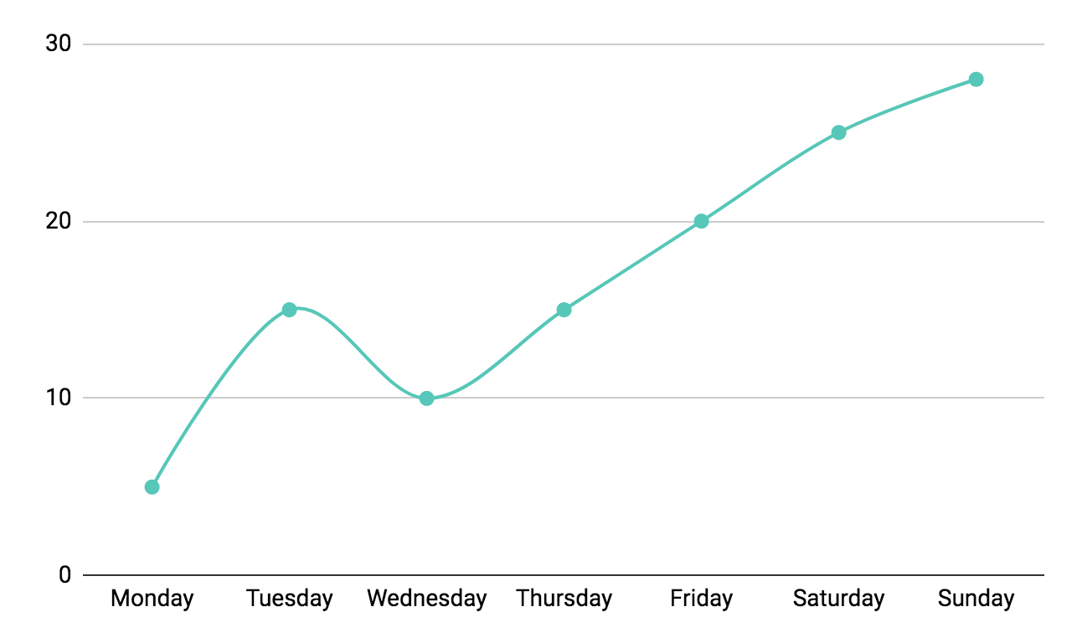
Weather Forecast Infographics
28°C
Sunday
85%
ENE 8
Follow the link in the graph to modify its data and then paste the new one here. For more info, click here

Slide 27
Weather Forecast Infographics
Mercury
Venus
Rainy
Sunny
22°C / 71.6°F
22°C / 71.6°F
Mars
Jupiter
Sunny
Rainy
22°C / 71.6°F
22°C / 71.6°F

Slide 28
Infographics
You can add and edit some infographics to your presentation to present your data in a visual way.
Choose your favourite infographic and insert it in your presentation using Ctrl C + Ctrl V or Cmd C + Cmd V in Mac.
Select one of the parts and ungroup it by right-clicking and choosing “Ungroup”.
Change the color by clicking on the paint bucket.
Then resize the element by clicking and dragging one of the square-shaped points of its bounding box (the cursor should look like a double-headed arrow). Remember to hold Shift while dragging to keep the proportions.
Group the elements again by selecting them, right-clicking and choosing “Group”.
Repeat the steps above with the other parts and when you’re done editing, copy the end result and paste it into your presentation.
Remember to choose the “Keep source formatting” option so that it keeps the design. For more info, please visit Slidesgo School.

